Slide 1
NSBE an Engineer
Industrial Engineering Edition

Slide 2
What’s an Industrial Engineer?
The ‘that was easy’ button
Industrial Engineers get called on to come in and make a process easier and more efficient for either a workforce, consumers, or a product
An Industrial Engineer understands the financial, technical, and social interactions that go into making a decision.

Slide 3
Who hires IE’s?
Accenture
Delta Airline
Eaton Corporation
Johnson and Johnson
Northrop Grumman
Raytheon
Honeywell
Johnson Controls
Pepsi
Disney
Pretty much any company, organization, or corporation who needs to make their processes and products easier, cheaper, or ergonomically (meaning people-friendly) better! So there are tons of opportunities!

Slide 4
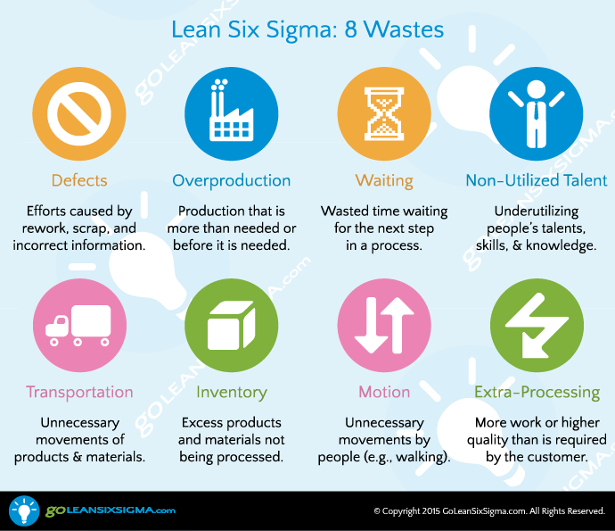
Elimination of ‘waste’
Industrial Engineers like to eliminate waste. There are 8 types of waste and you can easily remember them by remembering the acronym DOWNTIME

Slide 5
5S
5S is a methodology that Industrial Engineers like to use in order to make the workplace safe and more efficient. Try keeping 5S in mind the next time you clean your room!

Slide 6
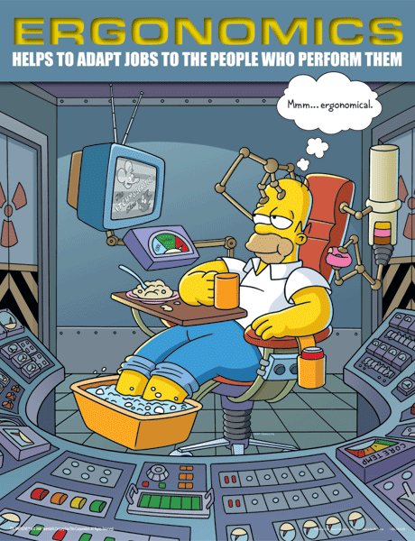
Ergonomics and Safety Engineering
Ergonomics is just a big word for things that make things easier and safer for a person. Industrial Engineers are often called on to make things in the work environment more friendly for the workers. Industrial Engineers also work to make a work environment safer and reduce work-related injuries by designing or implementing strategies or tools for the workers

Slide 7
Case Study
You work for a company that makes classroom furniture. The biggest complaint you receive from schools is that the desks and chairs that students use are uncomfortable and makes it harder for the students to learn. It’s your job to solve this problem
Deliverables
Drawing of a new desk design (by hand or through software)
Three examples of how your product is safe
Three examples of how your product is user-friendly
Cost analysis of the product

Slide 8
IE Activities and Resources For Advisors
Industrial Engineering Overview
http://www.livescience.com/48250-industrial-engineering.html
Industrial Engineering Overview with activities
http://www.sciencebuddies.org/science-engineering-careers/engineering/industrial-engineer#whatdotheydo
Free Resources for Lean Activities
http://www.leansimulations.org/
Complete 5S activity guide
http://superteams.com/files/SuperTeams5SGameHandout.pdf
Kanban Pizza activity
http://www.agile42.com/en/training/kanban-pizza-game/
Paper Airplane Lean activity
http://www.leansimulations.org/2012/09/more-lean-paper-airplanes-another-lean.html
Web-Based 3D CAD software (Free and Kid-Friendly)
www.tinkercad.com
www.3dtin.com

Slide 9
IE Quiz
1. What are the eight forms of waste? ( word scramble)
2. What classes are useful for IE’s
3. Fill in the blank: Ergonomics
4. Number the 5S in order
5. True or false: Disney has an internship for Industrial Engineers

